Slide 1
PROGRESS REPORT
16/10/23

Slide 2
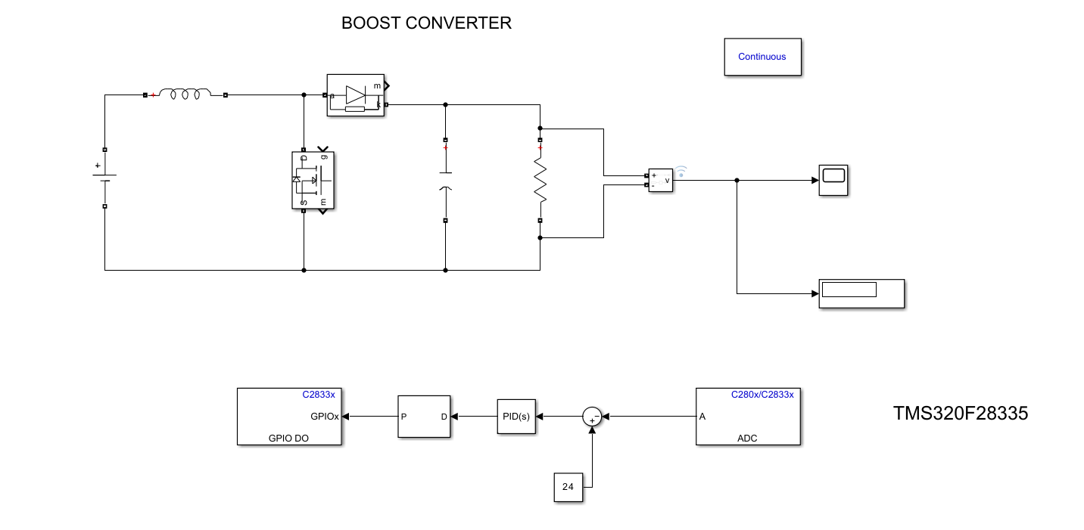
Implementation of Boost Converter Through Hardware

Slide 3
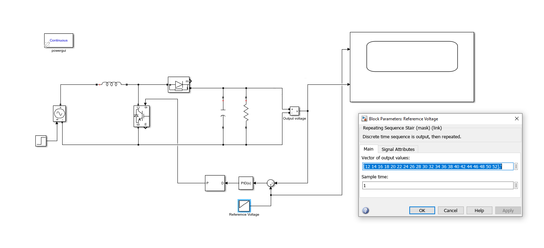
PID With changing reference voltage

Slide 4
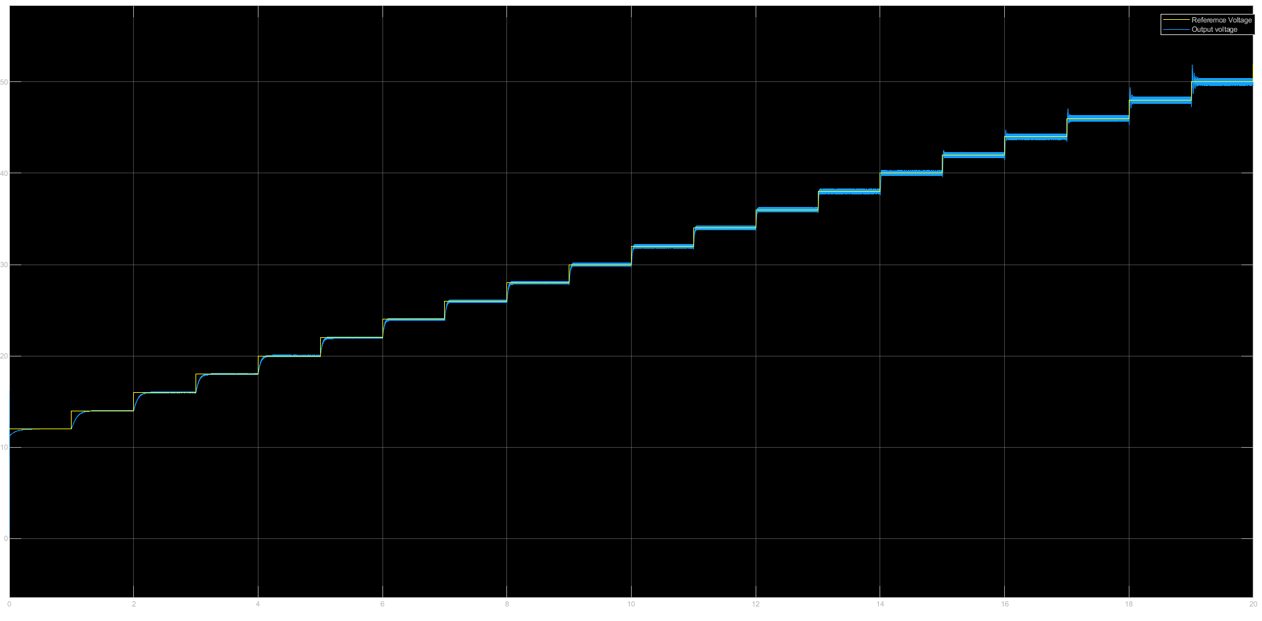

Slide 5
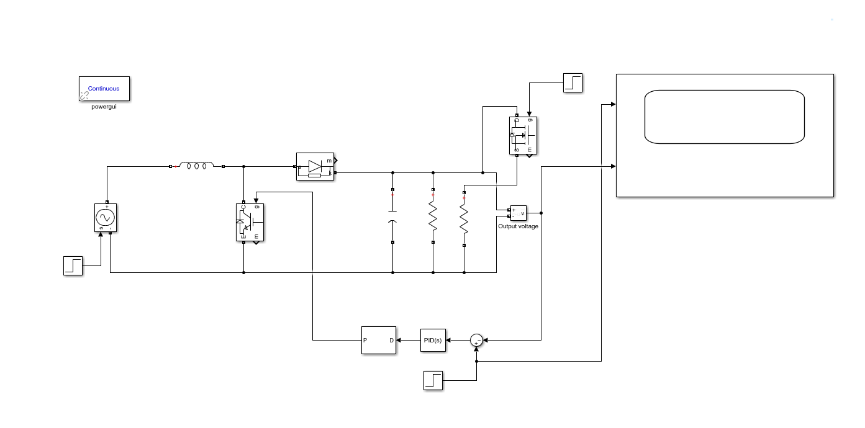
PID with sudden load

Slide 6
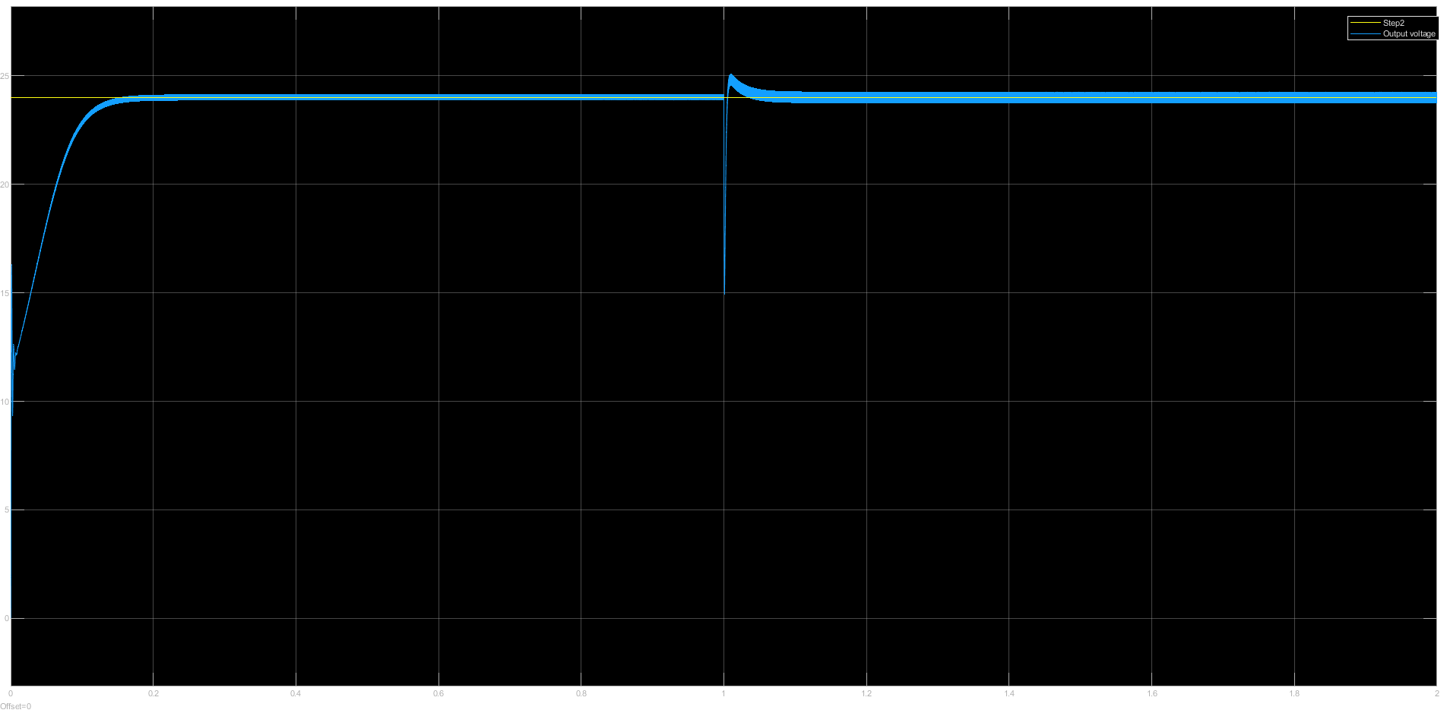

Slide 7
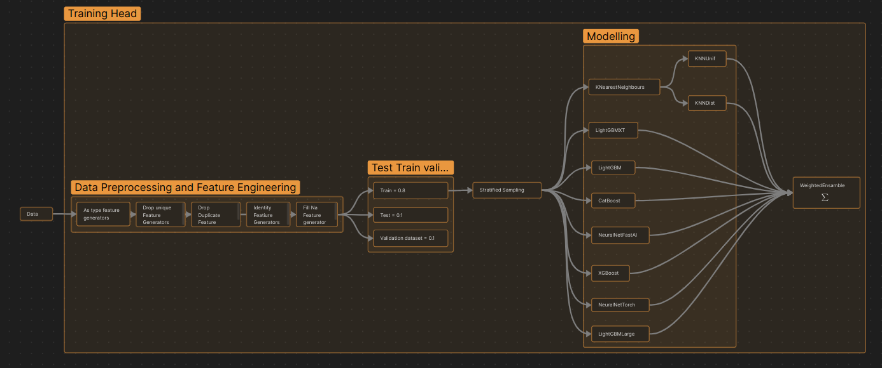
Model Training

Slide 8
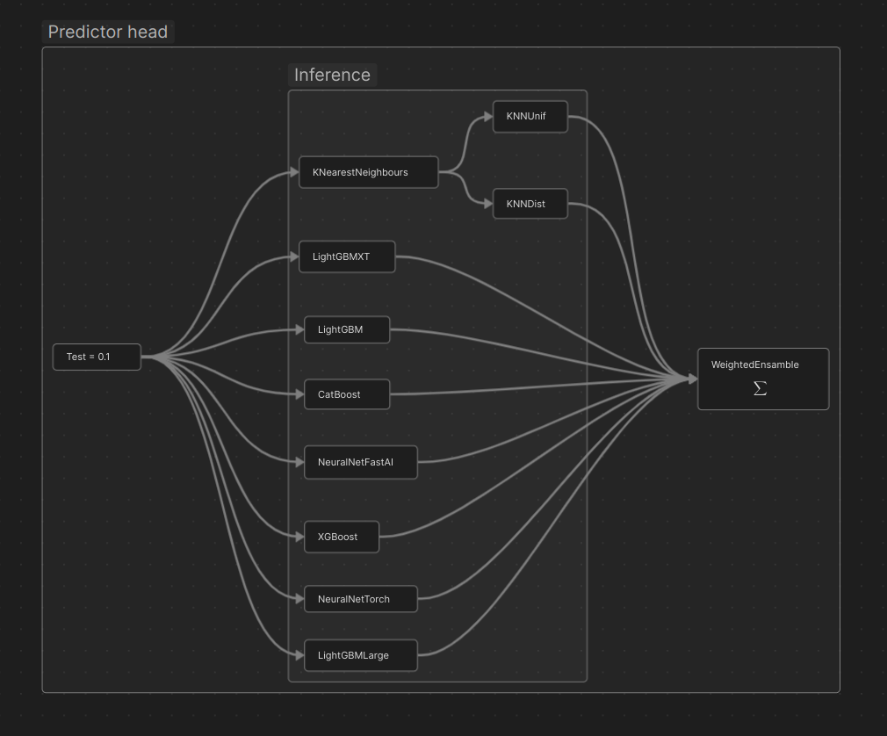
Inference

Slide 9
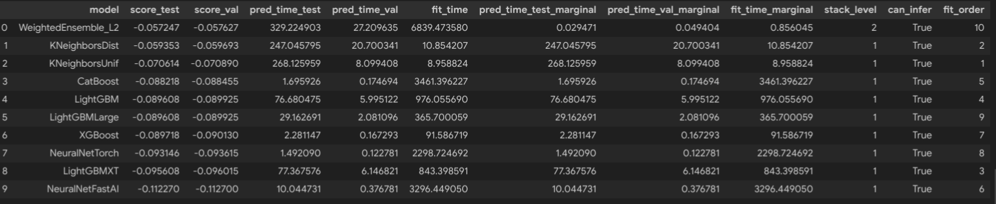
Metrics
Total Stats on test Dataset:
'root_mean_squared_error': -0.05724734420109342,
'mean_squared_error': -0.0032772584180784646,
'mean_absolute_error': -0.016703822914661326,
'r2': 0.8968713027968321,
'pearsonr': 0.9471164700048609,
'median_absolute_error': -0.001211921343385769}

Slide 10
Future Scope
Try with PWM Signal as output for model training
Try with 2 (Vo and Vref) as input instead of their subtraction
Hardware implementation

